Slide 1
What’s New in C#9
Jason Bock

Slide 2
Personal Info
http://www.jasonbock.net
https://www.twitter.com/jasonbock
https://www.github.com/jasonbock
jason.r.bock@outlook.com

Slide 3
Downloads
https://github.com/JasonBock/WhatsNewInCSharp9
https://github.com/JasonBock/InlineMapping
https://github.com/JasonBock/Presentations

Slide 4
Overview
Language Evolution
C#9 Features
Future Directions
Remember…
https://github.com/JasonBock/WhatsNewInCSharp9
https://github.com/JasonBock/InlineMapping
https://github.com/JasonBock/Presentations

Slide 5
Language Evolution
What’s New in C#9

Slide 6
C#
Est. 2002
Notes:
It’s hard to believe that C# has been around since 2002. Along the way it’s picked up a fair amount of features.

Slide 7
Version 1
Classes
Structs
Interfaces
Events
Properties
Delegates
Expressions
Statements
Attributes
Literals
Notes:
Version 1 had some “standard” language features that one would arguably expect from an OOP language.
https://github.com/dotnet/csharplang/blob/master/Language-Version-History.md#c-10-visual-studionet

Slide 8
Version 2
Generics
Partial types
Anonymous methods
Iterators
Nullable types
Getter/setter separate accessibility
Method group conversions (delegates)
Co- and Contra-variance for delegates and interfaces
Static classes
Delegate inference
Notes:
Version 2’s biggest addition was generics. That alone made coding easier to write, especially when it came to collections.
https://github.com/dotnet/csharplang/blob/master/Language-Version-History.md#c-2-vs-2005

Slide 9
Version 3
Implicitly typed local variables
Object and collection initializers
Auto-Implemented properties
Anonymous types
Extension methods
Query expressions
Lambda expression
Expression trees
Partial methods
Notes:
LINQ was the biggest addition for C#3. With it came a whole slew of features to support it.
https://github.com/dotnet/csharplang/blob/master/Language-Version-History.md#c-3-vs-2008

Slide 10
Version 4
Dynamic binding
Named and optional arguments
Generic co- and contravariance
Embedded interop types ("NoPIA")
Notes:
Verison 4 added some “interesting” features, with dynamic opening the door to C# being a little less type-safe.
https://github.com/dotnet/csharplang/blob/master/Language-Version-History.md#c-4-vs-2010

Slide 11
Version 5
Asynchronous methods
Caller info attributes
Notes:
Version 5’s biggest (and maybe only) feature is async/await, making asynchronous/concurrent programming easier.
https://github.com/dotnet/csharplang/blob/master/Language-Version-History.md#c-5-vs-2012

Slide 12
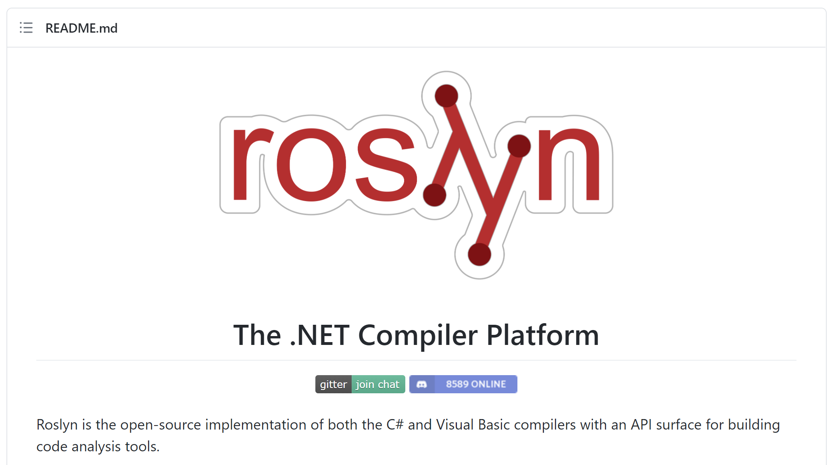
Notes:
The language space is open source. You can download the source code to the compilers and hack away (and submit pull requests if you’d like). You can watch as the language teams discuss current and potentially future changes. This is completely unlike the .NET of 2002.
https://github.com/dotnet/roslyn

Slide 13

Notes:
You can see who has contributed to Roslyn.
https://github.com/dotnet/roslyn/graphs/contributors

Slide 14
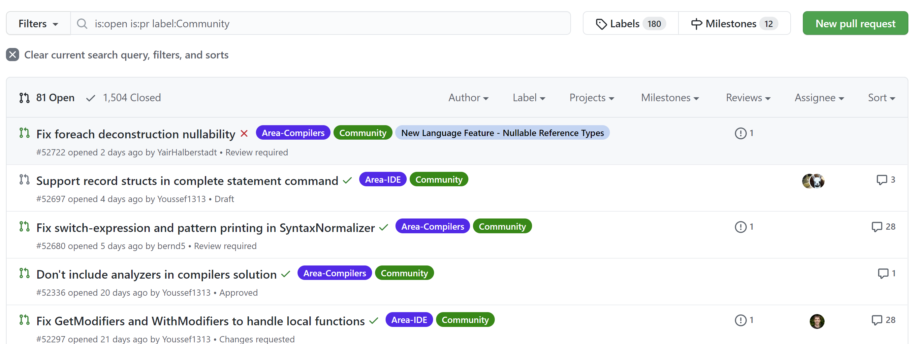
Notes:
There’s a “Community” tag so you can see which PRs have been tagged with that.
https://github.com/dotnet/roslyn/pulls?q=is%3Aopen+is%3Apr+label%3ACommunity

Slide 15
Version 6
Compiler-as-a-service (Roslyn)
Import of static type members into namespace
Exception filters
Await in catch/finally blocks
Auto property initializers
Default values for getter-only properties
Expression-bodied members
Null propagator (null-conditional operator, succinct null checking)
String interpolation
nameof operator
Dictionary initializer
Notes:
With Version 6, there’s a lot of small, yet useful, features. And it’s interesting to note that a fair amount of these (like string interpolation) went through a lot of changes before it reached its final destination. Some features, like primary constructors, have been dropped for now (though they may come back in a future version). All this work was driven a lot by the community and what really worked best.
https://github.com/dotnet/csharplang/blob/master/Language-Version-History.md#c-6-vs-2015

Slide 16
Version 7
Out variables
Pattern matching
Tuples
Deconstruction
Discards
Local Functions
Binary Literals
Digit Separators
Ref returns and locals
Generalized async return types
More expression-bodied members
Throw expressions
Notes:
C#7 has continued the trend from C#6, with lots of small, yet useful features.
https://github.com/dotnet/csharplang/blob/master/Language-Version-History.md#c-70-visual-studio-2017

Slide 17
Version 7.1
Async main
Default expressions
Reference assemblies
Inferred tuple element names
Pattern-matching with generics
Notes:
But C#7 has bucked a trend by introducing point releases. C#7.1 was released with the VS2017 15.3 release, and we’ll cover those as well in this talk
https://github.com/dotnet/csharplang/blob/master/Language-Version-History.md#c-71-visual-studio-2017-version-153

Slide 18
Version 7.2
Ref readonly
Interior pointer/Span/ref struct
Non-trailing named arguments
private protected
Conditional ref operator
Digit separator after base specifier
Notes:
7.2 continued the point trend.
https://github.com/dotnet/csharplang/blob/master/Language-Version-History.md#c-72---visual-studio-2017-version-155

Slide 19
Version 7.3
Enum, delegate, and unmanaged constraints
Ref local re-assignment
Stackalloc initializers
Indexing movable fixed buffers
Custom fixed statement
Improved overload candidates
Expression variables in initializers and queries
Tuple comparison
Attributes on backing fields
Notes:
And now we have 7.3 with VS2017 15.7.
https://github.com/dotnet/csharplang/blob/master/Language-Version-History.md#c-73---visual-studio-2017-version-157

Slide 20
Version 8
Default Interface Methods
Nullable reference type
Recursive patterns
Async streams
Enhanced using
Ranges
Null-coalescing Assignment
Alternative interpolated verbatim strings
stackalloc in nested contexts
Unmanaged generic structs
Static local functions
Readonly members
Notes:
8.0 was released with .NET Core 3.0
https://github.com/dotnet/csharplang/blob/master/Language-Version-History.md#c-80---net-core-30-and-visual-studio-2019-version-163

Slide 21

Many of the C# 8.0 language features have platform dependencies. Async streams, indexers and ranges all rely on new framework types that will be part of .NET Standard 2.1. As Immo describes in his post Announcing .NET Standard 2.1, .NET Core 3.0 as well as Xamarin, Unity and Mono will all implement .NET Standard 2.1, but .NET Framework 4.8 will not. This means that the types required to use these features won’t be available on .NET Framework 4.8. Likewise, default interface member implementations rely on new runtime enhancements, and we will not make those in the .NET Runtime 4.8 either.
For this reason, using C# 8.0 is only supported on platforms that implement .NET Standard 2.1. The need to keep the runtime stable has prevented us from implementing new language features in it for more than a decade. With the side-by-side and open-source nature of the modern runtimes, we feel that we can responsibly evolve them again, and do language design with that in mind. Scott explained in his Update on .NET Core 3.0 and .NET Framework 4.8 that .NET Framework is going to see less innovation in the future, instead focusing on stability and reliability. Given that, we think it is better for it to miss out on some language features than for nobody to get them.
Notes:
Note that C#8 won’t fully work in .NET Framework 4.8
https://devblogs.microsoft.com/dotnet/building-c-8-0/#platform-dependencies
https://unsplash.com/photos/4Zaq5xY5M_c

Slide 22
Version 9
Records
Top-Level Statements
Pattern Matching Enhancements
Init Only Setters
Target-Typed New Expressions
Module Initializers
Extending Partial Methods
Static Anonymous Methods
Target-Typed Conditional Expressions
Covariant Return Types
Extension GetEnumerator
Lambda Discard Patterns
Attributes on Local Functions
Native Sized Integers
Function Pointers
Suppress Emitting localsinit Flag
Source Generators
Notes:
And now we have 9.0. Note that C#9 (and F#5) target .NET 5.
https://github.com/dotnet/csharplang/blob/master/Language-Version-History.md#c-90---net-5-and-visual-studio-2019-version-168

Slide 23
Demo: C#9 Features
What’s New in C#9

Slide 24
Version 9
Records
Top-Level Statements
Pattern Matching Enhancements
Init Only Setters
Target-Typed New Expressions
Module Initializers
Extending Partial Methods
Static Anonymous Methods
Target-Typed Conditional Expressions
Covariant Return Types
Extension GetEnumerator
Lambda Discard Patterns
Attributes on Local Functions
Native Sized Integers
Function Pointers
Suppress Emitting localsinit Flag
Source Generators
Notes:
To recap, here are the features in C#9.

Slide 25
Future Directions
What’s New in C#9

Slide 26

Notes:
So, where will C# go from here? As with any crystal ball gazing, sometimes the best we can do is guess. But with C# being OSS, it’s easier to see the roadmap, so let’s talk about some of the features that may show up in the future.
https://unsplash.com/photos/GY38n9WKjQI

Slide 27
Version “Next”
Record structs
Global using directive
Static Abstract Members In Interfaces
File-scoped namespace
Interpolated string improvements
Parameterless struct constructors
Lambda improvements
nameof(parameter)
Improved Definite Assignment
Relax ordering of ref and partial modifiers
Parameter null-checking
Caller expression attribute
Generic attributes
Default in deconstruction
Constant Interpolated Strings
Mix declarations and variables in deconstruction
List patterns
Extended property patterns
Sealed record ToString
Source Generator V2 APIs
Notes:
These may get in some future version of C#, or not, we don’t know yet.
References:
Source generators - https://github.com/dotnet/roslyn/blob/master/docs/features/generators.md
Records - https://github.com/dotnet/roslyn/blob/master/docs/features/records.md and https://github.com/dotnet/csharplang/blob/master/proposals/recordsv2.md
Roles, extension interfaces, and static interface members - https://github.com/dotnet/csharplang/issues/1711
https://github.com/dotnet/roslyn/blob/master/docs/Language%20Feature%20Status.md#c-next

Slide 28
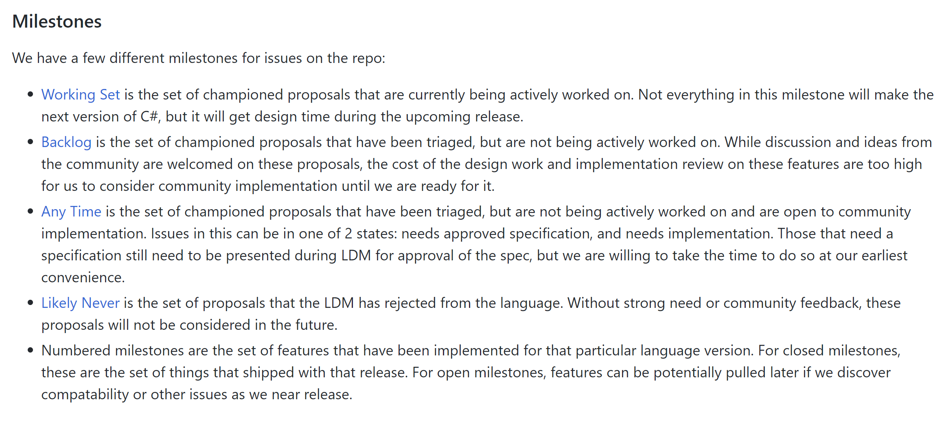
Notes:
This is another resource to look at language ideas and planning. The “Roles, extension interfaces, and static interface members” and “Type Classes” proposals are the ones that catch my eye.
https://github.com/dotnet/csharplang/blob/master/README.md#milestones

Slide 29
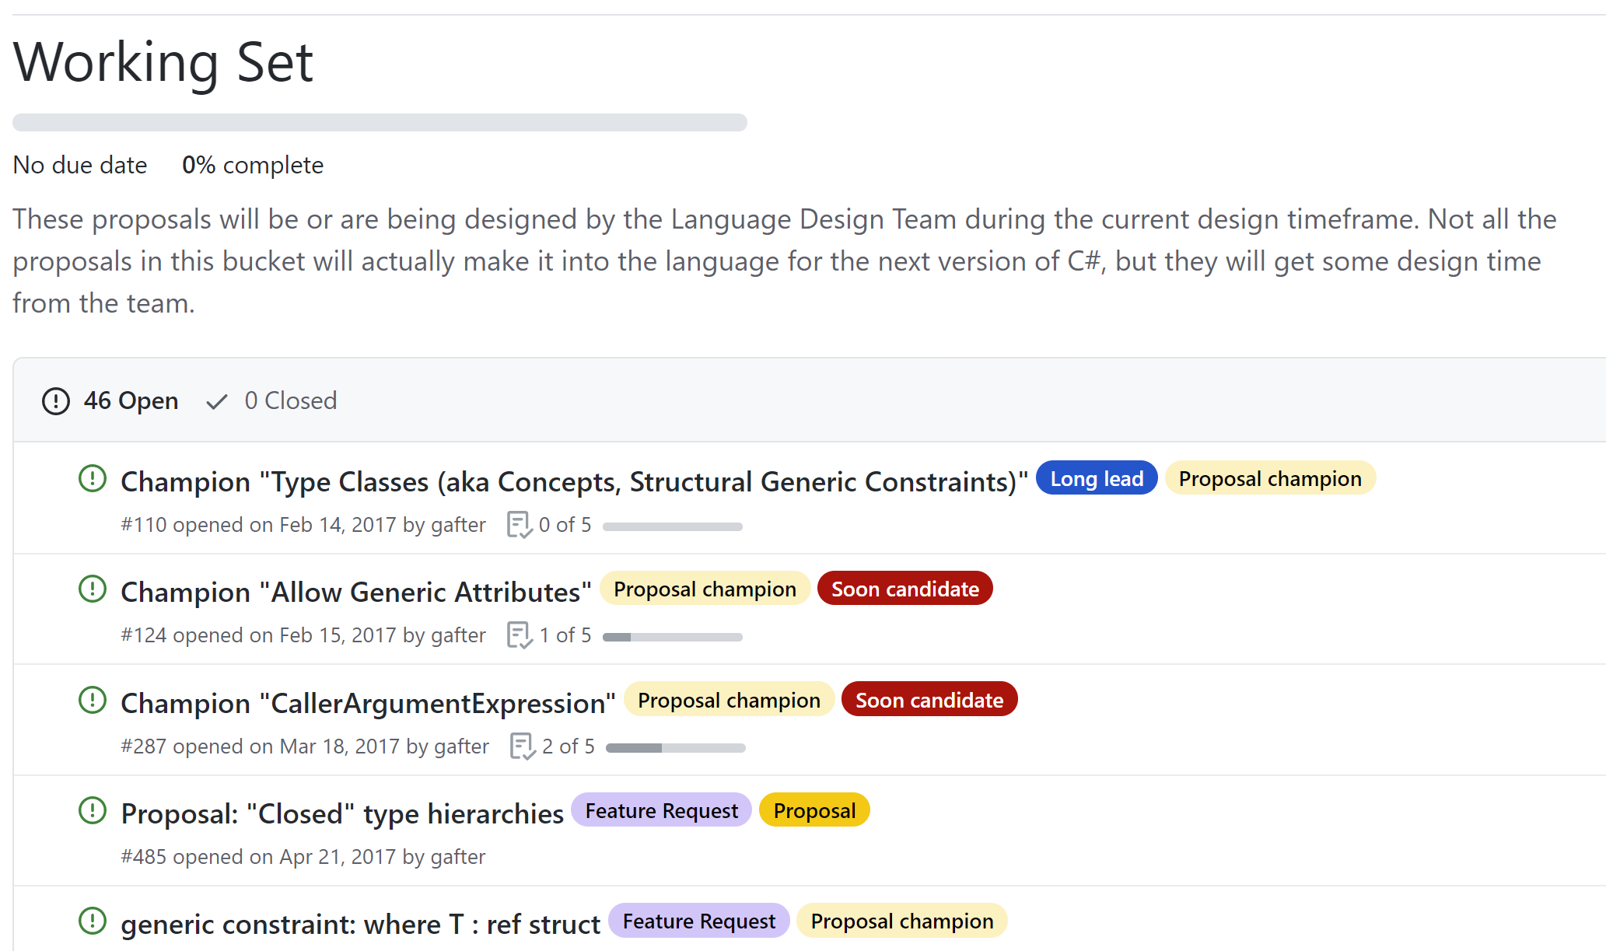
Notes:
This is another resource to look at language ideas and planning. The “Type Classes” one I’m hoping is eventually done.
https://github.com/dotnet/csharplang/milestone/19

Slide 30
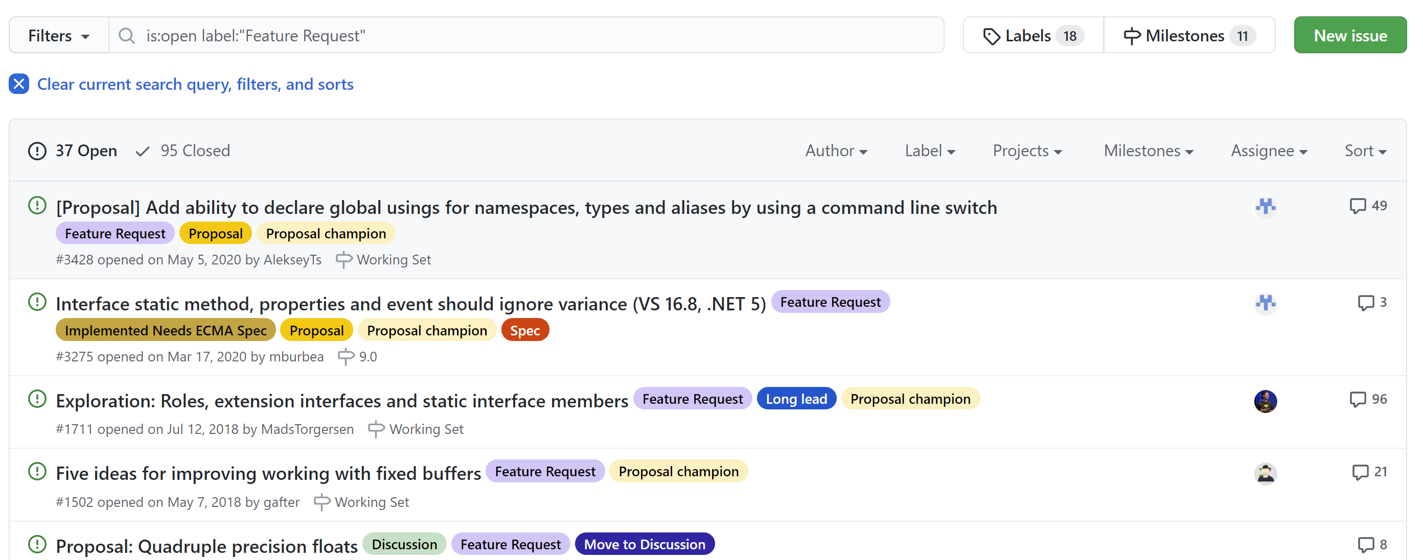
Notes:
If you have an idea, submit a feature request and see where it goes.
https://github.com/dotnet/csharplang/labels/Feature%20Request

Slide 31
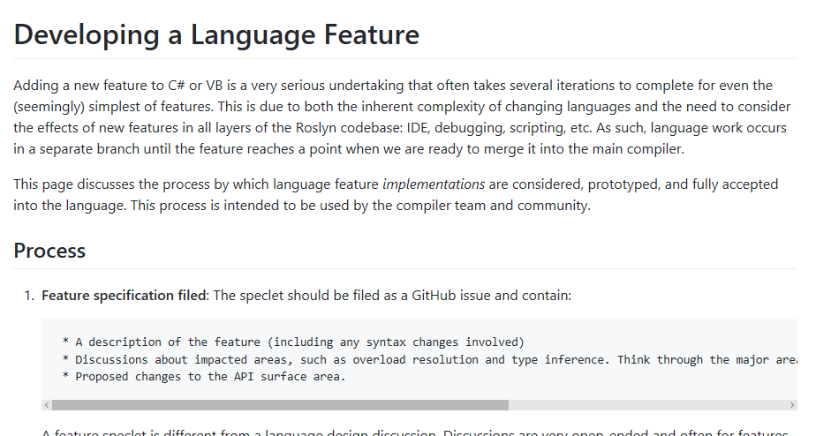
Notes:
Just follow the directions….also, keep in mind that if your idea will touch overloading in any way, the review process gets really complicated.
https://github.com/dotnet/roslyn/blob/master/docs/contributing/Developing%20a%20Language%20Feature.md

Slide 32

Notes:
YOU can influence the future direction if you want! The “more expressions-bodied members” was proposed and implemented by the community, so you can get involved!
https://unsplash.com/photos/7iatBuqFvY0

Slide 33
What’s New in C#9
Jason Bock
Remember…
https://github.com/JasonBock/WhatsNewInCSharp9
https://github.com/JasonBock/InlineMapping
https://github.com/JasonBock/Presentations
References in the notes on this slide
Notes:
## References
Features Added in C# Language Versions - https://github.com/dotnet/csharplang/blob/master/Language-Version-History.md
Language Feature Status - https://github.com/dotnet/roslyn/blob/master/docs/Language%20Feature%20Status.md
C# Guide - https://docs.microsoft.com/en-us/dotnet/csharp/
What's the strangest corner case you've seen in C# or .NET? - https://stackoverflow.com/questions/194484/whats-the-strangest-corner-case-youve-seen-in-c-sharp-or-net
Eliminating Nulls in C# - https://magenic.com/thinking/eliminating-nulls-in-c
Language Version Planning - https://github.com/dotnet/csharplang/projects/4
Language Design Meetings - https://github.com/dotnet/csharplang/tree/master/meetings
### C#.next (https://github.com/dotnet/roslyn/blob/master/docs/Language%20Feature%20Status.md#c-next)
* Caller expression attribute
* Generic attributes
* Default in deconstruction
### C#9
* [C# 9 - Improving performance using the SkipLocalsInit attribute](https://www.meziantou.net/csharp-9-improve-performance-using-skiplocalsinit.htm)
* JsonSrcGen + CoreRT = Pure Magic - https://trampster.blogspot.com/2020/09/jsonsrcgen-corert-pure-magic-in-my.html
* https://github.com/dotnet/roslyn/blob/master/docs/Language%20Feature%20Status.md#c-9
* https://docs.microsoft.com/en-us/dotnet/csharp/language-reference/proposals/csharp-9.0/records
* Reduce mental energy with C# 9 - https://daveabrock.com/2020/06/18/reduce-mental-energy-with-c-sharp
* Source Generator
* Introducing C# Source Generators - https://devblogs.microsoft.com/dotnet/introducing-c-source-generators/
* Source Generators Cookbook - https://github.com/dotnet/roslyn/blob/master/docs/features/source-generators.cookbook.md
* Demos - https://github.com/dotnet/roslyn-sdk/tree/master/samples/CSharp/SourceGenerators
* INotifyPropertyChanged with C# 9.0 Source Generators - https://jaylee.org/archive/2020/04/29/notify-property-changed-with-rosyln-generators.html
* C# Source Generators: Less Boilerplate Code, More Productivity - https://dontcodetired.com/blog/post/C-Source-Generators-Less-Boilerplate-Code-More-Productivity
* Using C# Source Generators with Microsoft Feature Management Feature Flags - https://dontcodetired.com/blog/post/Using-C-Source-Generators-with-Microsoft-Feature-Management-Feature-Flags
* StackOnlyJsonParser - https://github.com/TomaszRewak/C-sharp-stack-only-json-parser
* First Look: C# Source Generators - https://daveabrock.com/2020/05/08/first-look-c-sharp-generators
* Source Generators in C#](https://channel9.msdn.com/Shows/Visual-Studio-Toolbox/Source-Generators-in-CSharp
* Target-typed new
* Relax ordering of ref and partial modifiers
* Parameter null-checking
* Skip locals init
* Lambda discard parameters
* Native ints
* Attributes on local functions
* Function pointers
* Pattern matching improvements
* Static lambdas
* Records
* Target-typed conditional
* Covariant Returns
* Extension GetEnumerator
* Module initializers
* Extending Partial
* Top-level statements
### C#8
* Nullable reference types
* https://github.com/dotnet/roslyn/blob/master/docs/features/nullable-reference-types.md https://github.com/dotnet/roslyn/blob/master/docs/features/nullable-metadata.md
* https://docs.microsoft.com/en-us/dotnet/csharp/language-reference/proposals/csharp-8.0/nullable-reference-types-specification
* .NET Docs - https://docs.microsoft.com/en-us/dotnet/csharp/nullable-references
* Embracing nullable reference types - https://devblogs.microsoft.com/dotnet/embracing-nullable-reference-types/
* Reserved attributes contribute to the compiler's null state static analysis - https://docs.microsoft.com/en-us/dotnet/csharp/language-reference/attributes/nullable-analysis
* Ian Griffiths series - https://endjin.com/blog/2020/04/dotnet-csharp-8-nullable-references-non-nullable-is-the-new-default
* C# 8 Interfaces
* Static Members - https://jeremybytes.blogspot.com/2019/12/c-8-interfaces-static-members.html
* Public, Private, and Protected Members - https://jeremybytes.blogspot.com/2019/11/c-8-interfaces-public-private-and.html
* Dangerous Assumptions in Default Implementation - https://jeremybytes.blogspot.com/2019/09/c-8-interfaces-dangerous-assumptions-in.html
* A Closer Look at C# 8 Interfaces - https://jeremybytes.blogspot.com/2019/09/a-closer-look-at-c-8-interfaces.html
* Interfaces in C# 8 are a Bit of a Mess - https://jeremybytes.blogspot.com/2019/09/interfaces-in-c-8-are-bit-of-mess.html
Essential C# 8.0 - https://www.codemag.com/article/1911112
C#, Span and async - https://blogs.endjin.com/2019/10/c-span-and-async/
C# 8.0 and .NET Standard 2.0 - Doing Unsupported Things - https://stu.dev/csharp8-doing-unsupported-things/
"deferring" in C#8 - https://twitter.com/reubenbond/status/1184135702851678208
What's New in C#8 - https://docs.microsoft.com/en-us/dotnet/csharp/whats-new/csharp-8
This is how you get rid of null reference exceptions forever - https://channel9.msdn.com/Shows/On-NET/This-is-how-you-get-rid-of-null-reference-exceptions-forever
Alignment with C# 8 Switch Expressions - https://csharp.christiannagel.com/2019/09/17/switchexpressionalign/
Async Streams – A Look at New Language Features in C# 8 - https://blog.jetbrains.com/dotnet/2019/09/16/async-streams-look-new-language-features-c-8/
Eliminating Nulls in C# - https://magenic.com/thinking/eliminating-nulls-in-c
DIM
Default Interface Members and Inheritance - https://daveaglick.com/posts/default-interface-members-and-inheritance
Default Interface Members, What Are They Good For? - https://daveaglick.com/posts/default-interface-members-what-are-they-good-for
Update libraries to use nullable reference types and communicate nullable rules to callers - https://docs.microsoft.com/en-us/dotnet/csharp/nullable-attributes
Try out Nullable Reference Types - https://devblogs.microsoft.com/dotnet/try-out-nullable-reference-types/
C# 8 Pattern Matching Enhancements - https://www.infoq.com/news/2019/06/CSharp-8-Pattern-Matching/
Tutorial: Using pattern matching features to extend data types - https://docs.microsoft.com/en-us/dotnet/csharp/tutorials/pattern-matching
Default implementations in interfaces - https://devblogs.microsoft.com/dotnet/default-implementations-in-interfaces/
C#8, .NET Framework and .NET Core Divergence - https://twitter.com/dotMorten/status/1105343335164596224?s=09
Async Streams with C#8 - https://csharp.christiannagel.com/2019/03/20/asyncstreams/
.NET Core 3.0 vs. .NET Framework - https://twitter.com/dotMorten/status/1105343335164596224?s=09
Much Ado about Nothing: A C# play in two acts.
Part 1 - https://www.youtube.com/watch?v=GusJQNjj_2g
Part 2 - https://www.youtube.com/watch?v=lVDYwA-BcwE
Adapting Projects to Use C# 8 and Nullable Reference Types - https://www.infoq.com/articles/csharp-nullable-reference-case-study
NullableAttribute and C#8 - https://codeblog.jonskeet.uk/2019/02/10/nullableattribute-and-c-8/
Update on IAsyncDisposable and IAsyncEnumerator - https://www.infoq.com/news/2019/01/IAsyncDisposable-IAsyncEnume
Do more with patterns in C# 8.0 - https://blogs.msdn.microsoft.com/dotnet/2019/01/24/do-more-with-patterns-in-c-8-0/
Take C# 8.0 for a spin - https://blogs.msdn.microsoft.com/dotnet/2018/12/05/take-c-8-0-for-a-spin/
Containing Null with C# 8 Nullable References - https://praeclarum.org/2018/12/17/nullable-reference-types.html
C# 8: Pattern Matching Extended - https://csharp.christiannagel.com/2018/07/03/patternmatchingcs8/
Writing operators - https://github.com/akarnokd/async-enumerable-dotnet/wiki/Writing-operators
Optimizing C# Struct Equality with IEquatable and ValueTuples - https://montemagno.com/optimizing-c-struct-equality-with-iequatable/
C# 8 - Jon Skeet and Mads Torgersen - https://www.youtube.com/watch?v=gGUYUJmssYM
The future of C# (Build 2018) - https://channel9.msdn.com/Events/Build/2018/BRK2155
First steps with nullable reference types - https://codeblog.jonskeet.uk/2018/04/21/first-steps-with-nullable-reference-types/
A Preview of C# 8 with Mads Torgersen - https://channel9.msdn.com/Blogs/Seth-Juarez/A-Preview-of-C-8-with-Mads-Torgersen
Introducing Nullable Reference Types in C# - https://blogs.msdn.microsoft.com/dotnet/2017/11/15/nullable-reference-types-in-csharp/
Herding Nulls and Other C# Stories From the Future - https://www.infoq.com/presentations/c-sharp-future
### Before C#8
How Microsoft rewrote its C# compiler in C# and made it open source - https://medium.com/microsoft-open-source-stories/how-microsoft-rewrote-its-c-compiler-in-c-and-made-it-open-source-4ebed5646f98
Tuples, deconstruction, and dictionaries - https://twitter.com/davidpine7/status/1032706884569059328
Interesting uses of tuple deconstruction - https://compiledexperience.com/blog/posts/abusing-tuples
Performance traps of ref locals and ref returns in C# - https://blogs.msdn.microsoft.com/seteplia/2018/04/11/performance-traps-of-ref-locals-and-ref-returns-in-c/
Memory Management, C# 7.2 and Span<T> - https://speakerdeck.com/slang25/memory-management-c-number-7-dot-2-and-span
Using In Parameter Modifier - C# 7.2 - https://codewala.net/2018/03/27/using-in-parameter-modifier-c-7-2/
Essential .NET - C# 8.0 and Nullable Reference Types - https://msdn.microsoft.com/en-us/magazine/mt829270.aspx
C# 7 Series, Part 6: Read-only structs - https://blogs.msdn.microsoft.com/mazhou/2017/11/21/c-7-series-part-6-read-only-structs/
What's new in C# 7.2 - What's new in C# 7.2
What's new in C# 7.2 - https://docs.microsoft.com/en-us/dotnet/csharp/whats-new/csharp-7-2
C# 7.2: Understanding Span - https://channel9.msdn.com/Events/Connect/2017/T125
C# Language Internals - https://www.youtube.com/watch?v=1lnwO63LhRI
Dissecting the local functions in C# 7 - https://blogs.msdn.microsoft.com/seteplia/2017/10/03/dissecting-the-local-functions-in-c-7/
C# 7.1 - Everything You Need To Know - https://www.danielcrabtree.com/blog/329/c-sharp-7-1-everything-you-need-to-know
C# 7, 8 and Beyond: Language Features from Design to Release to IDE Support - https://www.infoq.com/presentations/csharp-7-8-language-features
Perusing C# 7.1 - http://davidpine.net/blog/csharp-seven-dot-one/
Exploring C# 7 - http://davidpine.net/blog/exploring-csharp-seven/
Tuples and Generics - https://magenic.com/thinking/tuples-and-generics-in-c7
Tuples and Deconstruction in C#7 - https://magenic.com/thinking/tuples-and-deconstruction-in-c7
C#7 Series
Value Tuples: https://blogs.msdn.microsoft.com/mazhou/2017/05/26/c-7-series-part-1-value-tuples/
Async Main: https://blogs.msdn.microsoft.com/mazhou/2017/05/30/c-7-series-part-2-async-main/
Default Literals: https://blogs.msdn.microsoft.com/mazhou/2017/06/06/c-7-series-part-3-default-literals/
Discards: https://blogs.msdn.microsoft.com/mazhou/2017/06/27/c-7-series-part-4-discards/
Private Protected: https://blogs.msdn.microsoft.com/mazhou/2017/10/05/c-7-series-part-5-private-protected/
Read-Only Structs: https://blogs.msdn.microsoft.com/mazhou/2017/11/21/c-7-series-part-6-read-only-structs/
Ref Returns: https://blogs.msdn.microsoft.com/mazhou/2017/12/12/c-7-series-part-7-ref-returns/
"in" Parameters: https://blogs.msdn.microsoft.com/mazhou/2018/01/08/c-7-series-part-8-in-parameters/
Ref Structs: https://blogs.msdn.microsoft.com/mazhou/2018/03/02/c-7-series-part-9-ref-structs/
Span<T> and universal memory management: https://blogs.msdn.microsoft.com/mazhou/2018/03/25/c-7-series-part-10-spant-and-universal-memory-management/
Expression – Bodied Members in C# 7.0 - http://dailydotnettips.com/2017/07/17/expression-bodied-members-in-c-7-0/
Abolishing Switch-Case Statement and Pattern Matching in C# 7.0: https://rubikscode.net/2017/06/18/abolishing-switch-case-and-pattern-matching-in-c-7-0/
C# 7 – Simplify and Improve Your Code in 2017: https://channel9.msdn.com/Events/DEVintersection/DEVintersection-2017-Orlando/DEV005
C# 7.x and 8.0: Uncertainty and Awesomeness: https://www.erikheemskerk.nl/c-sharp-7-2-and-8-0-uncertainty-awesomeness/
C# 7.1 and Beyond: Polishing Usability - https://www.erikheemskerk.nl/c-sharp-7-1-polishing-usability/
C# 7.2 and 8.0 Roadmap - https://www.infoq.com/news/2017/06/CSharp-7.2
An Early Look at C# 7.1: Part 1 - https://www.infoq.com/news/2017/06/CSharp-7.1-a
An Early Look at C# 7.1: Part 2 - https://www.infoq.com/news/2017/06/CSharp-7.1-b
The Future of C# - https://channel9.msdn.com/Events/Build/2017/B8104
What's new in C# 7 - https://docs.microsoft.com/en-us/dotnet/articles/csharp/whats-new/csharp-7
Patterns and Practices in C# 7 - https://www.infoq.com/articles/Patterns-Practices-CSharp-7
New Features in C# 7.0 - https://blogs.msdn.microsoft.com/dotnet/2017/03/09/new-features-in-c-7-0/
C#7 Tools (see other related articles from this author) - http://blog.somewhatabstract.com/2017/02/20/c7-tools/
.NET Framework - What's New in C# 7.0 - https://msdn.microsoft.com/en-us/magazine/mt790184.aspx
Nested Functions: https://en.wikipedia.org/wiki/Nested_function (think function to delete files, needs recusion, local functions makes this elegant, but is it performant?)
C# 7 Work List of Features - https://github.com/dotnet/roslyn/issues/2136
What's New in C#7 - https://blogs.msdn.microsoft.com/dotnet/2016/08/24/whats-new-in-csharp-7-0/
Language Feature Status - https://github.com/dotnet/roslyn/blob/master/docs/Language%20Feature%20Status.md
Visual Studio "15" Preview 5 - https://www.visualstudio.com/news/releasenotes/vs15-relnotes#cshappvb
Language Feature Status - https://github.com/dotnet/roslyn/blob/master/docs/Language%20Feature%20Status.md

